Slide 1
Connection Oriented Transport: TCP
Transfer Control Protcol

Slide 2

Agenda
The TCP Connection
TCP Segment Structure
Round-Trip Time Estimation and Timeout
Reliable Data Transfer
Flow Control

Slide 3



Transmission Control Protocol (TCP)
Fundamental communication protocol in computer networking. It operates at the transport layer of the OSI model and plays a crucial role in ensuring reliable and orderly data transmission over the internet and other interconnected networks. It works hand in hand with the Internet Protocol (IP) to form the basis of the widely used TCP/IP protocol suite

Slide 4
Connection Oriented Protocol
(TCP)

Slide 5

Connection Oriented Protocol
Communication Protocol is one that establishes and maintains a logical connection b/w two devices.
This connection ensures that data is transmitted reliably and in the correct order b/w sender and receiver.

Slide 6

The TCP Connection
TCP is Connection-Oriented
application process “handshake” with each other.
must send some pre-liminary segments to each other
This Photo by Unknown Author is licensed under CC BY-SA-NC

Slide 7


Connection Oriented Transport: TCP
Full-Duplex Service
Data can flow from one process to another and vice versa simultaneously.
Point to Point
The transfer of data from one sender to many receivers in a single send operation is not possible.

Slide 8
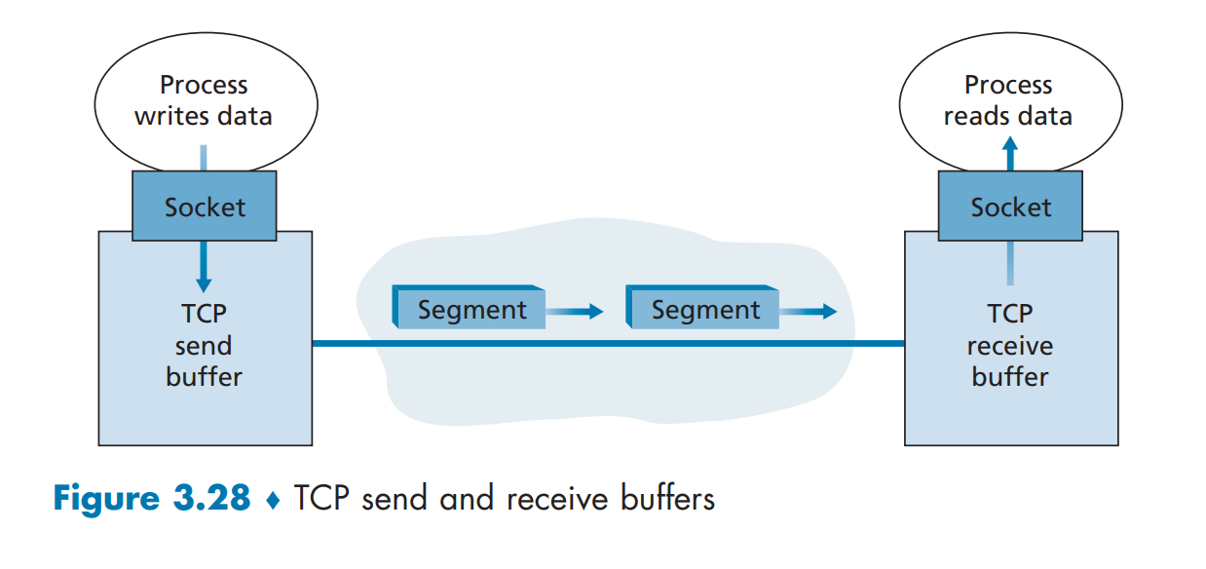
Establishment of connection
Client/Server Process
clientSocket.connect((serverName,serverPort)) > port identifies process on the server
Three Way Hand-Shake
Connection Establishment
Maximum Segment Size (MSS)

Slide 9
TCP Segment Structure

Slide 10
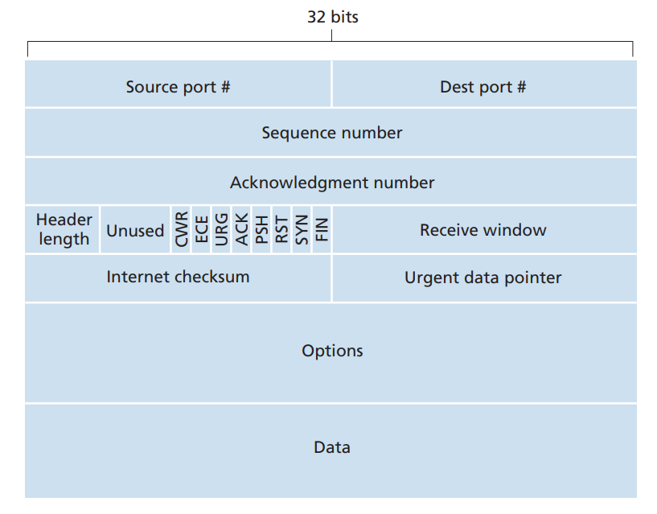
TCP Segment Structure
Header field
Data field
Source & Destination Ports
Checksum field(integrity)
Sequence number field
Acknowledgment number field

Slide 11
TCP Segment Structure
Receive window field
Header length field(32bit)
Options field (MSS)
Flag field(6 bits)
ACK, RST, SYN, FIN, PSH,URG

Slide 12
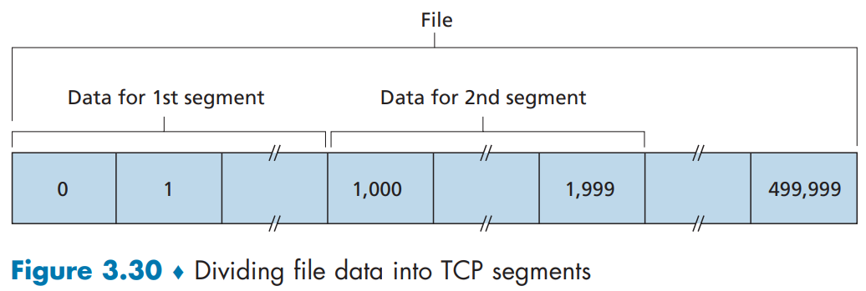
Establishment of connection
Sequence number for a segment
Acknowledgement Number

Slide 13
TCP Implementation
There are basically two choices:
the receiver immediately discards out-of-order segments
the receiver keeps the out-of-order bytes and waits for the missing bytes to fill in the gaps

Slide 14
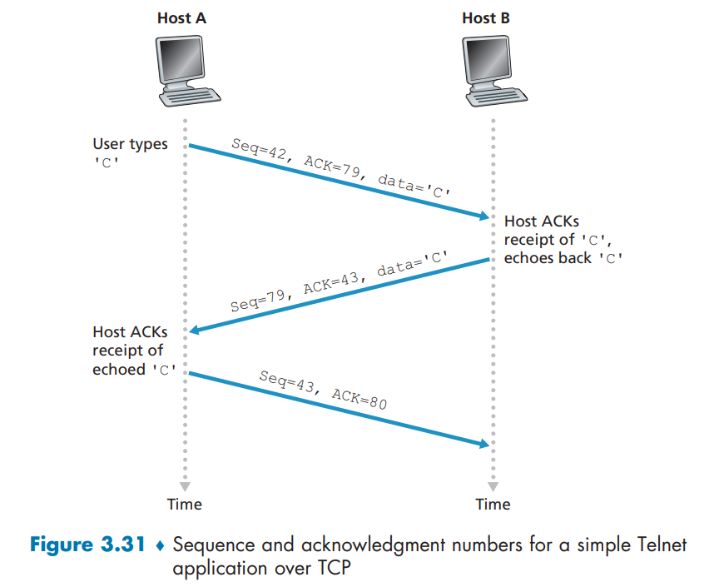
Telnet: A Case Study
Telnet, popular application-layer protocol used for remote login.
Unlike the bulk data transfer, Telnet is an interactive application.
Piggybacked

Slide 15


Gamification
Gamification is defined as the application of game design and elements in nongame contexts.
It is Used as a motivational technique to encourage and facilitate new behaviors.
It initially emerged in the business and marketing sectors implementing techniques such as loyalty cards and stamp books for increased customer loyalty and retention.

Slide 16
How to Change SPI
Process
1
Structure
2
Management
3
People
4

Slide 17
General Results
Introduction of Gamification in SPI: The first primary study introducing gamification in Software Process Improvement (SPI) was in 2012, proposing to use gamification as a solution in the context of SPICE.

Slide 18


Challenges
Defining the target audience of gamifying SPI
Defining the expected outcome from gamifying SPI
Designing different gamification strategies for different organizational roles

Slide 19


Managing Additional Efforts:
Gamifying a process should not impose a significant change that enforces learning about gamification or completely transforming the way people work
Github to Gamiware

Slide 20


Gamification
A Motivational Technique
To Encourage and Facilitate new behaviours
Implementing Gamification in SPI
Issues To Resolve
Engagement & Motivation (of people)
Comitment (towards goals)
Communication (gap)
Impact we achive
Increased Motivation (of people)
Use of Tool (Gamiware -> Gitlab)
Enhanced Knowledge & Performance

Slide 21

The way to get started is to quit talking and begin doing.
Walt Disney

Slide 22

Thank you
Presentation by Group 6
Salman Naeem
Numan Ahmad
Farjad Waseem
22

